Slide 1

Scraping Allrecipes

Slide 2
What is Allrecipes?
“the world’s largest food-focused social network with a community of 40 million home cooks consuming 3 billion pages annually of food inspiration across our 19 sites serving 24 countries in 13 languages.”

Slide 3
Why Allrecipes?
Data comes in standardized format with nutritional info.
Several drawbacks:
Kicked off repeatedly
Ajax requests necessary
Poor labeling of recipes

Slide 4
What did I do?
I scraped across different categories of recipes.
Went deep into several categories specifically.
Regrouped all observations together.

Slide 5
Vital Domain Knowledge
"With enough butter, anything is good."
- Julia Child
“Life without veal stock, pork fat, sausage, organ meat, demi-glace, or even stinky cheese is a life not worth living.”
- Anthony Bourdain

Slide 6
How do people decide on ratings?
Evaluating a recipe on a numeric scale is a complex task.
Meal quality is determined by 3 things: Ingredients, chef skill level, recipe.
My hypothesis is that salt, fat and carbohydrates a potent tool for recipe authors.
The experience of reading and executing the recipe will likely be important as well.

Slide 7
My Hypothesis Was Incorrect
Greatest observable statistical difference is between food types.
Beef is rated higher than chicken, and chicken is rated higher than pasta.
Furthermore, they exhibit very different variances.
Bartlett's K-squared = 93.58, df = 5, p-value < 2.2e-16
No relationship evident with fat content, sodium content, nor any other nutrient profile.

Slide 8
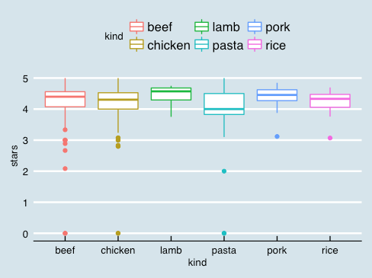
*All categories of recipe exhibit similar properties.
Median between 4 and 4.5
Mean between 4 and 4.5
Lower tail between 3 and 4.
*Lamb has median of 4.57. Low number of observations is a relevant factor.

Slide 9
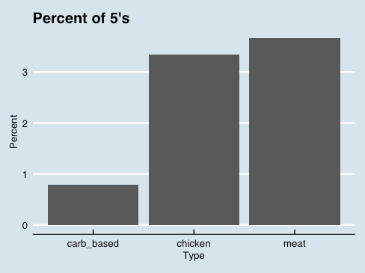
Meat exhibits a larger number of 5 star ratings than rice, pasta and noodle dishes.

Slide 10
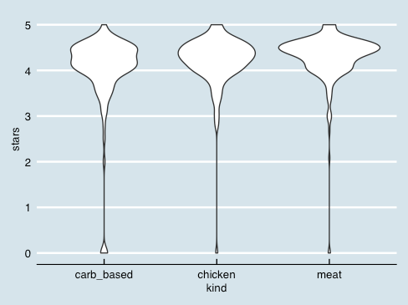
The Meat Mystery
As can be seen here, there seems to be a concentration of ratings near 4.5 for meat dishes.

Slide 11
Reasons for Observed Distribution
Carb based dishes clearly have a longer lower tail than either meat based or chicken based dishes.
This can be interpreted in many different ways.
Seems to suggest recipe matters less for meat based dishes than chicken or carb based dishes.
Somewhat consistent with initial hypothesis:
Home cooks do more consistently good cooking with high fat base ingredients.
Chicken and carbohydrate based dishes require more skill respectively.

Slide 12
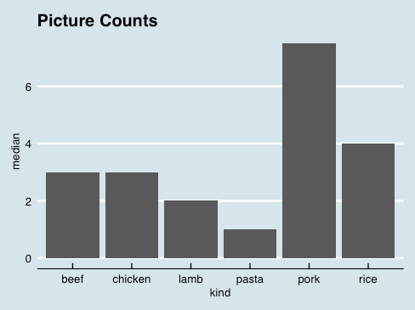
Pork is beautiful.
Pasta is not.
...Usually.
Pork has higher mean and median picture counts than beef and chicken combined.
This rule has one major exception...

Slide 13
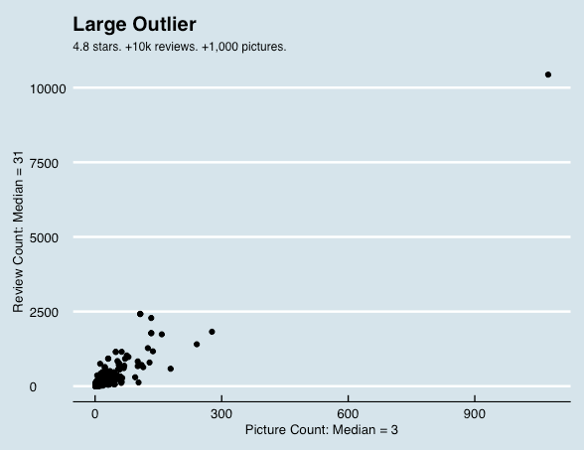
Popularity dynamics.
The recipes exhibit differences in popularity disproportionate to their quantitative and qualitative differences.

Slide 14
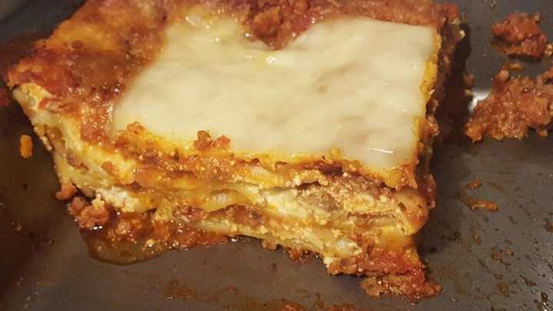

World’s Best Lasagna
Layout of the website exhibits a self-reinforcing winner-take-all cycles, elevating popular recipes to extremes.
For this reason, John Chandler, a 47 year old self described ‘Entirely Anglo Saxon” salesman published what is likely the most popular recipe in the English language.
Random feedback loops create chaos.
Most popular lasagna.

Slide 15
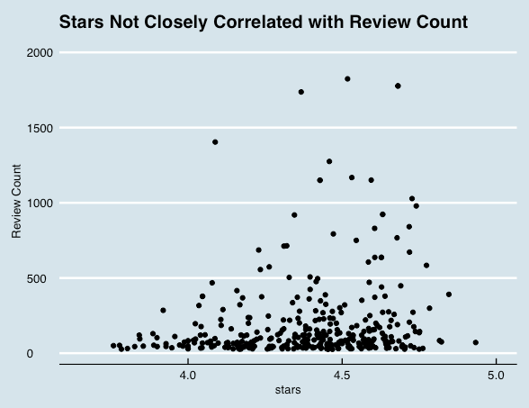
Meredith Corp Shareholders Should be Angry
Meredith Corp purchased Allrecipes for $175 Million in 2012.
Chandler’s lasagna is not top rated on site.
Stars are not closely related to review count indicating that vital information is not communicated.
Allrecipes should use data science to push for a linear graph from bottom left to top right.
Current system puts wrong content in front of the wrong people.
Multi dimensional rating systems and machine learning could improve performance.

